Slide 1


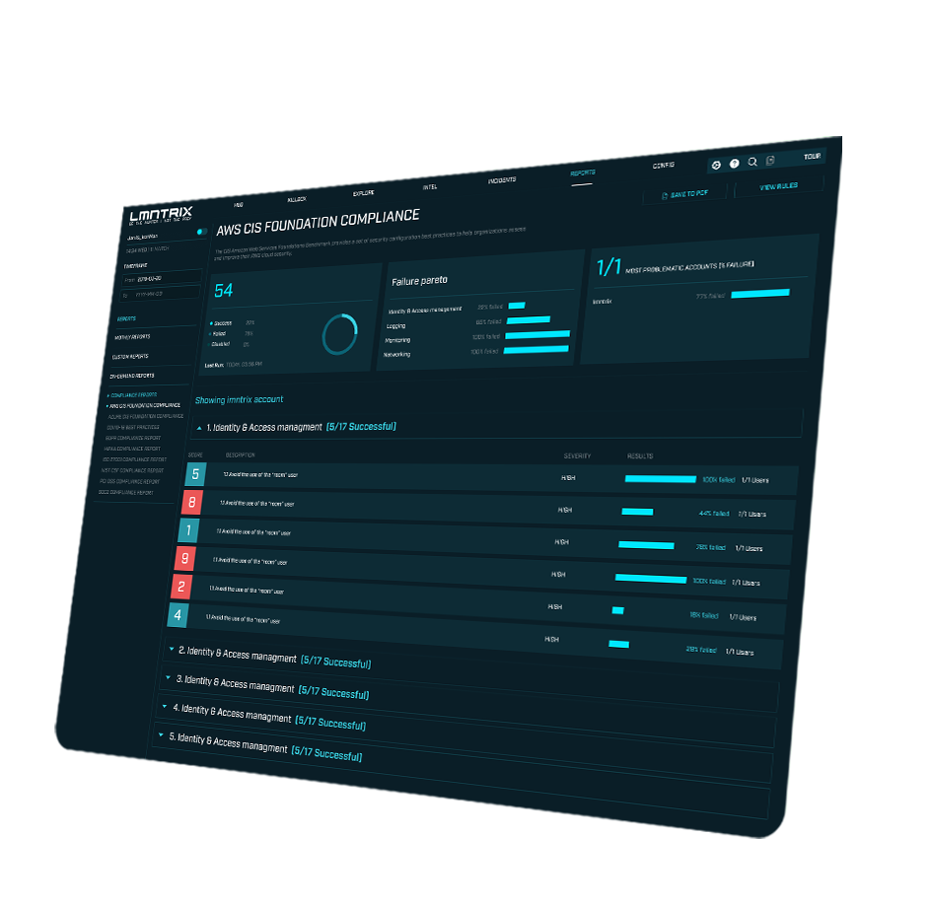
LMNTRIX
CLOUD
XDR
December 2023

Slide 2







What Questions does LMNTRIX Answer?
LMNTRIX XDR platform provides Multi-layered protection for computing infrastructure and workloads hosted in public cloud environments. In 2022, it took 207 days to discover a breach and an additional 70 days to remediate.
Am I currently being breach and is it valid?
Free Foundational Capabilities
Have I been breached previously and if so, are the steps repeatable?
Identity Threat
Detection & Response
Can I anticipate what the next steps the threat actor will take?
Our storyline will show what has already occurred and
where the threat actor may be going.
Cloud Threat Detection
& Response
Can I fix the gaps in my infrastructure quickly?
Recommendations are provided to fix the gaps in runtime.

Slide 3



Cloud Threat Landscape
90%
75%
50%
50%
Permissions
Misconfigurations
Data Breach
Public Exposure
In 2022 Nearly Half of all data breaches over the last year were cloud-based
By 2023 75% of security failures will result from inadequate management of identities, access, and privileges
By 2021 50% of enterprises will unknowingly and mistakenly have a service exposed to the public internet
By 2023 99% of cloud security failures will be the customer’s

Slide 4





Business Benefits
Compliance Requirements
Fortify Cloud
Security Posture
Eliminate Excessive Permissions
Comply with regional or industry regulations
Prevent Vulnerabilities
before they occur
Analyzing the gap between defined and used permissions
GDPR | HIPAA | NIST ISO 27001 | SOC2 | CIS | PCI DSS | GDPR | COVID 19
Misconfiguration Detection | Smart hardening recommendation | Risk prioritized alerting | Cross Cloud visibility | Multi Cloud support
Visibility | Automation of principle of least privileges | Continues analysis of granted and used permissions | Hardening recommendation
Intelligent Detection of Data Breach Attempts
Multi Cloud Visibility
Comprehensive view of your cloud security posture
Intelligent Detection & Correlation of Cyber Attack
Automated discovery of cloud assets inventory | Centralized management | Visibility into security risks across accounts, Regions & Multiple cloud vendors
Context aware detection | Auto response | Storage access active monitoring | Network communication monitoring | Suspicious cloud activity detection | Data exfiltration detection

Slide 5
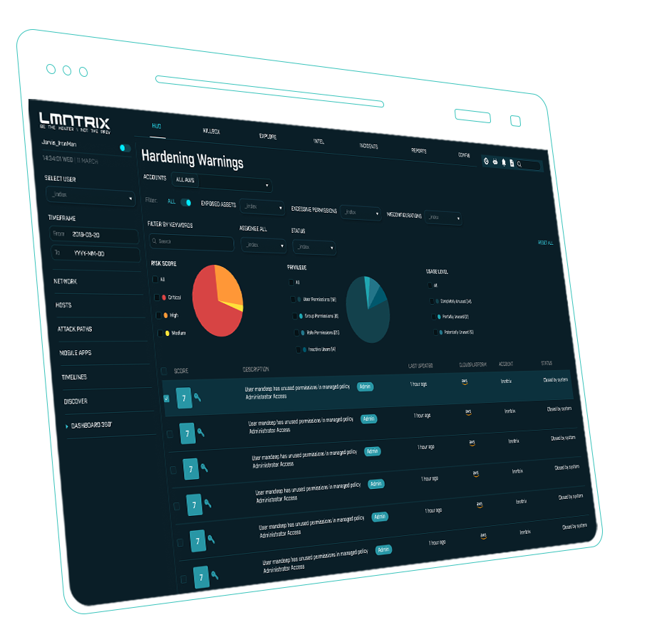
LMNTRIX XDR CLOUD
Key Product Attributes
SaaS cloud security platform
Quickly execute proof-of-value with your customers
Maintain account control
Single solution for compliance (CSPM), permission hardening (CIEM), real-time threat detection and remediation (CDR)
Log-based and agentless minimizes production impact
Secure the cloud without disrupting business operations

Slide 6
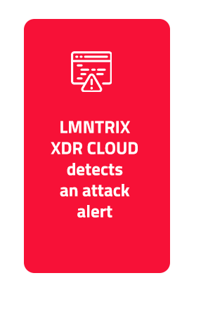
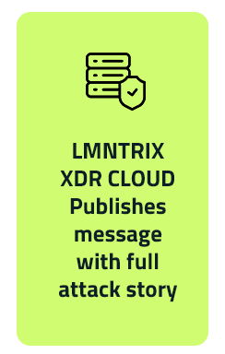
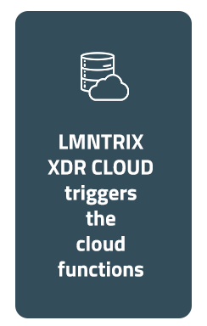
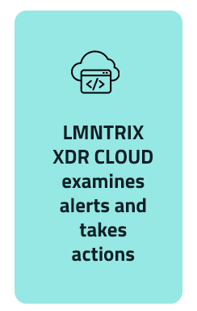







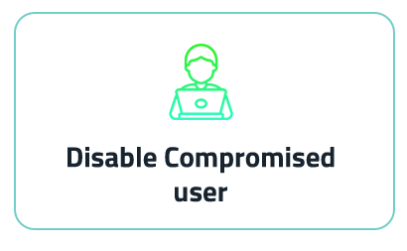
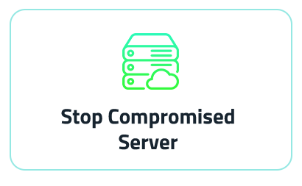
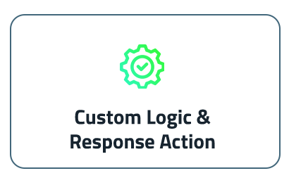
User-Defined Automated Response
Automated response within LMNTRIX XDR CLOUD addresses compliance/governance issues
(aka misconfigurations), public exposures and re-alert.

Slide 7

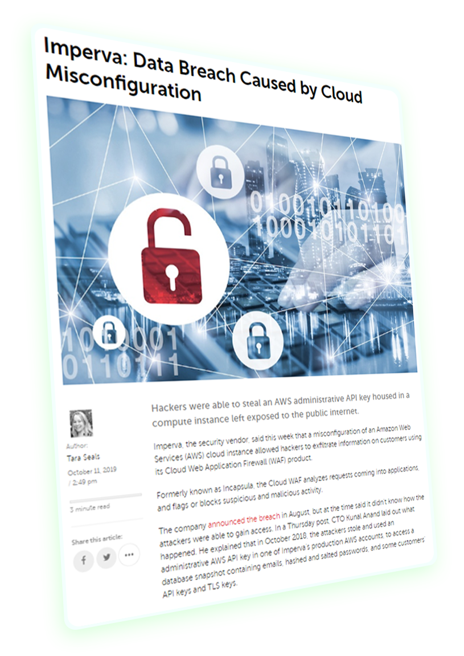

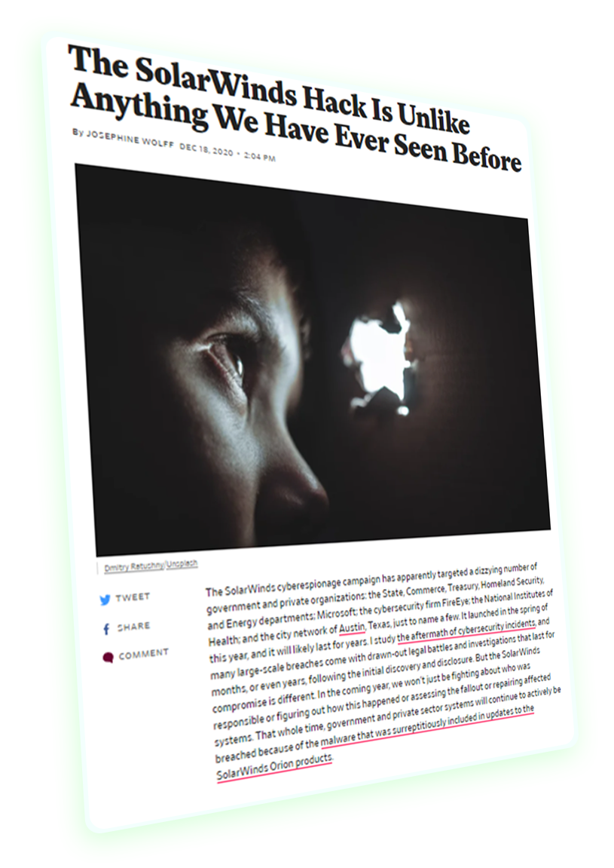
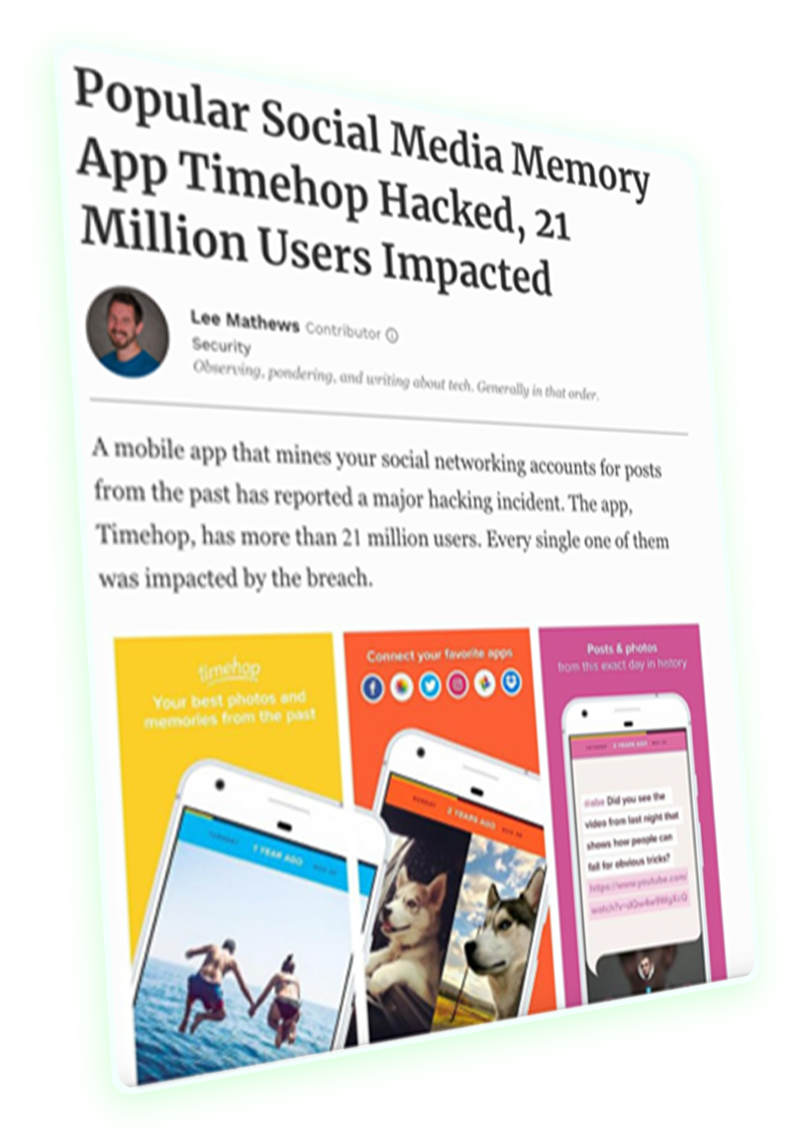

LMNTRIX XDR CLOUD
Key Product Attributes
Imperva
Data breach caused by misconfiguration
Capital One
Data Exfiltration of 100M records
Timehop
Data breach of 21M users
Facebook
Public Exposure of user PI

Slide 8







Real-time Observability
Cloud Threat Detection and Response
Runtime Observability
infiltration , lateral movement and exfiltration
Rules and ML detectors generating
MBIs
Detect and remediate IAM, Cloud and Network anomalies with continuous runtime observability measured with ML models contextualized for your cloud
Identity Threat Detection and Response
LMNTRIX
XDR
CLOUD
Sequence
builder to generate Attacks Storyline
Anomalous User and Role behavior
Prevent unnecessary cloud permissions for users, roles and resources and their subsequent breaches; reduce the permission attack surface
Scoring &
Risk Center prioritizing permission,MBIs hardening,public exposure & misconfigs
Anomalous
North-South
& East-West
traffic
Integration
Authenticated RESTful API Mail, Teams, Slack, Jira, PagerDuty, Azure Sentinel, S3 Logger

Slide 9
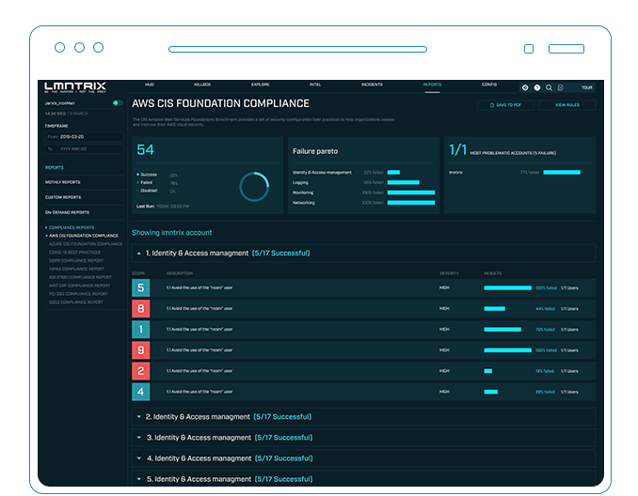
Real-time Observability
Malicious Behavior Indicators are monitored in real time
Indicators are correlated into related events and graphically illustrated.
No need for a team to review logs for days and reconstruct the telemetry, etc.
10 events but only one alert – reduce mean time to protect in minutes
All evidence is aggregated and correlated into one console eliminating the need to look at 5 different systems

Slide 10

LMNTRIX XDR CLOUD
Threat Detection
CONTEXT
MONITOR
INDENTIFY
Baseline Monitoring
provides context
Actively monitors cloud for suspicious activities
Identifies 70+ Malicious Behavior Indicators (MBIs)
CORELATE
MITIGATION
Correlates individual events into attack storyline
Automated response options for rapid mitigation

Slide 11
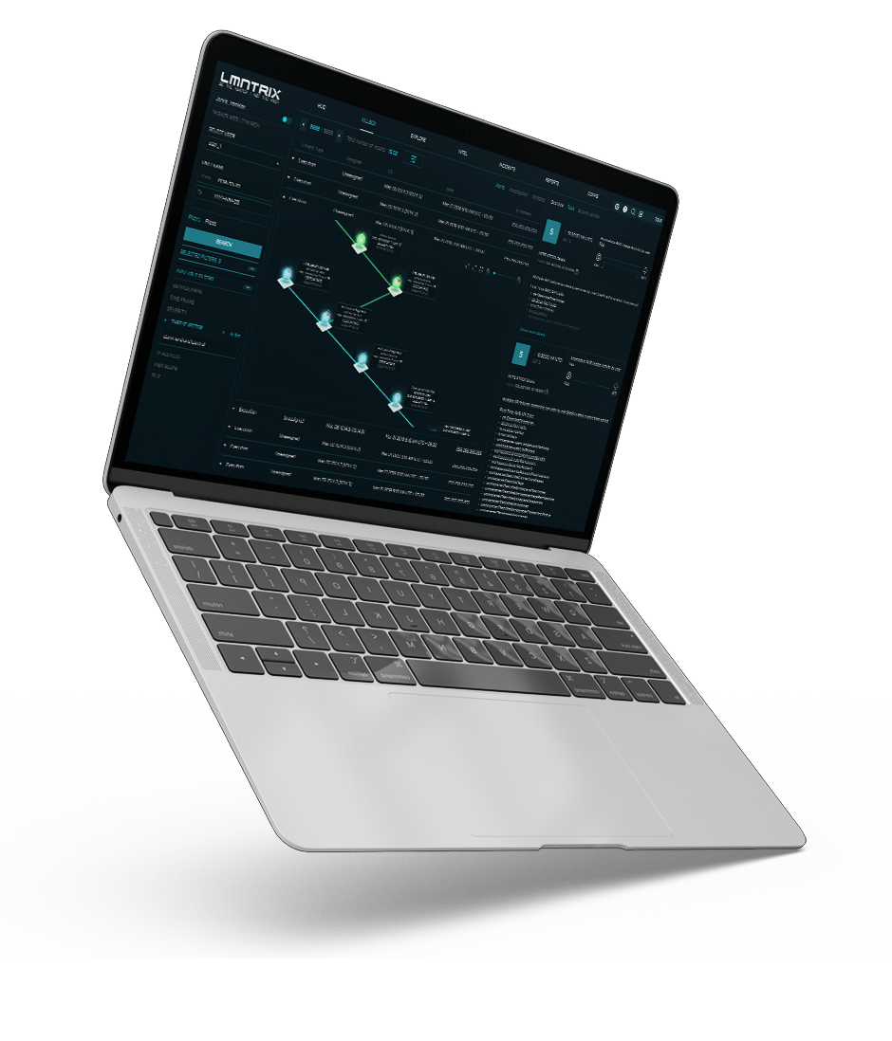
One-click Attack Simulation
Actively TEST YOUR DEFENSES with 1-click simulations
Attacks based on REAL-LIFE data-breach incidents
Test both SYSTEMS and PROCESSES
Identify weaknesses BEFORE THEY ARE EXPLOITED

Slide 12
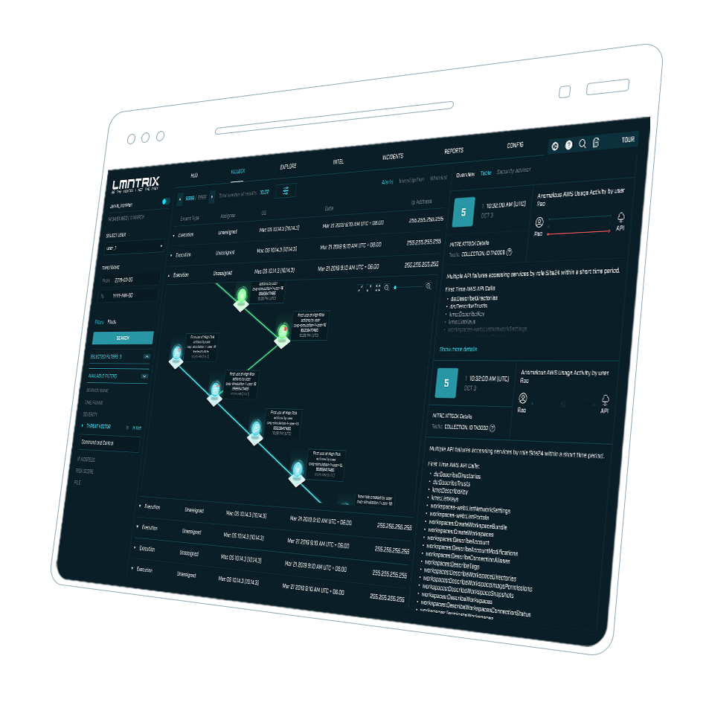
How the Simulation helps You sell
Find vulnerabilities and threats in the existing infrastructure to show immediate value
Demonstrate to your cloud customers how you can enable their business to operate securely in the cloud
Showcasing your cloud expertise, showcases
the value in your cloud services

Slide 13



Proof of Value Process – 14 days
Onboarding & Instant Security Assessment
PoVSummary
Continuous monitoring of cloud accounts for exposures, misconfiguration and attacks/breaches during the PoV period. Conclude the PoV &
discuss next steps
Grant LMNTRIX access to collect logs and configuration data.Self-onboard cloud accounts and get public exposure, misconfiguration and compliance assurance results within minutes.
After
3/7
Days
Kickoff
After
1 Day
Check-In, Hardening Review
& Attack Simulation
After 14 Days
PoV Process Overview Timeline, Success Criteria definition & Technical requirements
Progress against success criteria, customer feedback & questions. Review representative warnings. Optionally (AWS), simulate and detect cloud-native attack scenarios in customer environment.

Slide 14

Thank you
info@lmntrix.com

