Slide 1


How LMNTRIX MOBILE can shape trust in a mobile digital world
Carlo Minassian – Founder & CEO
Feb 2023

Slide 2


What does LMNTRIX MOBILE do?
It secures mobile!
LMNTRIX MOBILE secures mobile experience and applications so they can access enterprise data in a safe and secure manner.

Slide 3






Why We Do it?
LMNTRIX Protects Digital Transformation
Remote Working
Bring Your Own Device (BYOD)
Office 365 & Cloud Apps
We address enterprise risk by lowering it from mobile threats and attacks on endpoints and apps. Therefore, increasing the overall mobile security posture
Mobile Apps
Zero Trust
Compliance Mandates

Slide 4






Recognized Industry Leader
Industry Recognition
Awards & Accolades
“
  Cyber Security Excellence Awards:
  2020 Gold Winner in Mobile Threat Defense
Market Guide for Mobile Threat Defense Solutions
Zimperium (LMNTRIX MOBILE OEM Vendor) named representative vendor
  Cyber Security Excellence Awards:
  2020 Silver Winner in Best Cybersecurity Company
  2020 Most Innovative Enterprise Mobile Threat Defense
“
“
IDC MarketScape: Worldwide Mobile Threat Management Software (2018 – 2019)
" Zimperium’s MTD product has a strong machine learning (ML)–based core function, which creates a baseline of normal mobile device activity and behavior, then monitors, alerts, and mitigates threats based on deviations from the baseline.”
“A very powerful solution.”
“Love the option to create group policies so we can address the needs of our different populations.”
“Their keen intuition and insight on what mobile security needs, is what makes them so successful.”

Slide 5



Why Partner with LMNTRIX
Enterprise Mobile Security Market Leader
Growth Market
  Mobile EPP & EDR
  Mobile App Security (DevOps / SecOps / AppSec)
  Mobile App Compliance (PCI / GDPR / HIPPA etc..)
Native integration with LMNTRIX XDR
Integrated with all 3rd party UEM / MDM / MAM vendors
  Easy deployment via UEM / MDM / MAM
GDPR compliant, Privacy centric BYOD
Large EcoSystem
  Deep Partnership with Unified Endpoint Management & EDR players

Slide 6



Mobile Endpoint Protection:
Mobile Threat Defense (MTD)

Slide 7
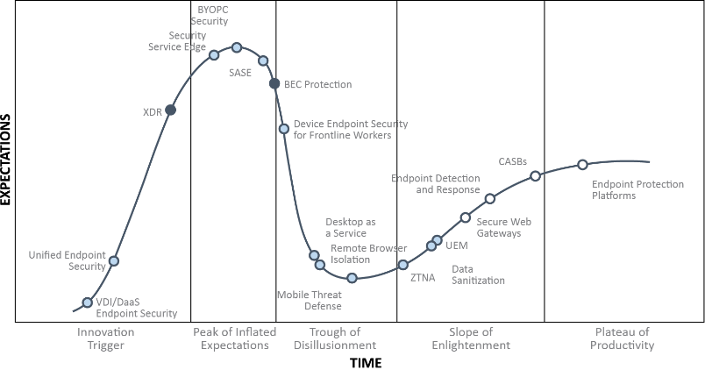
Market Maturity
Mobile Endpoint Security
Total Addressable Market for Mobile Endpoint Security
  The global mobile security market size is expected to grow from USD 3.0 billion in 2019 to USD 7.2 billion by 2024, at a Compound Annual Growth Rate (CAGR) of 19.4% during the forecast period.
What's Driving Growth
  Increased reliance on mobile endpoints for corporate work, highlighted by access to O365 and other enterprise cloud services
  Rising BYOD trend among enterprises
  Higher costs due to mobile breaches and attacks
  Distributed and hybrid workforces
  Unique, regional data laws and compliance standards
  Privacy regulation and government regulations
Mobile Threat Defense
Notes:
Source: https://www.marketsandmarkets.com/Market-Reports/mobile-security-market-227793897.html

Slide 8

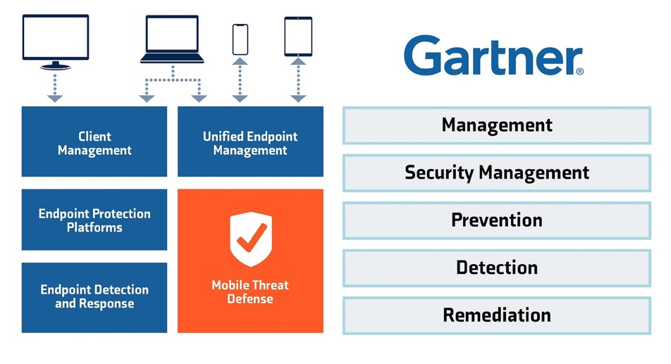
Enterprises Need
Mobile Threat Defense (MTD)
Relationship between Mobile Threat Defense and other endpoint security and management tools

Slide 9
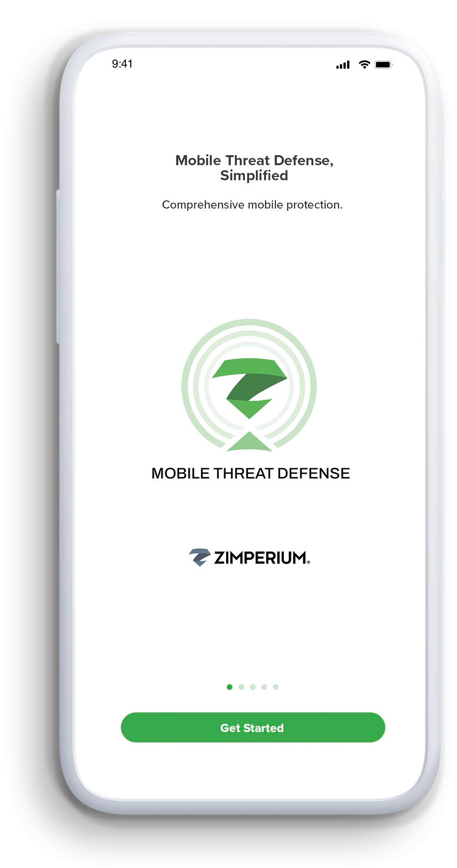
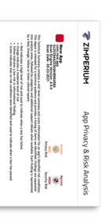


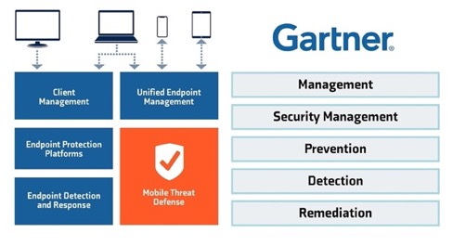










Mobile Threat Defense
On-Device Protection
Phishing
Content Filtering
Device
Network
Apps
Advanced App Analysis
Malware classification
Privacy rating
Security ratings
Executive & Technical reports
Platforms Supported – iOS | Android | Chrome OS
Security Integrations
Mobile Device Integrations
Mobility Integrations
OEM
OEM
OEM

Slide 10









What Are We
Protecting You From?
Phishing Attacks
90/60
    90% of breaches start with phishing;
    60% of emails read on mobile²
Device Attacks
65%
Avg. % of enterprise devices running an OS with CRITICAL vulnerabilities
Malicious websites
60% of endpoints in an enterprise are mobile
Protection to defend users from web threats & enforce corporate governance & compliance
Attacks by bad actors
Network Attacks
1:5
One in five enterprise mobile devices experienced a network attack⁴
Risks from employees
Application Malware
482,579
New mobile malware per month¹

Slide 11


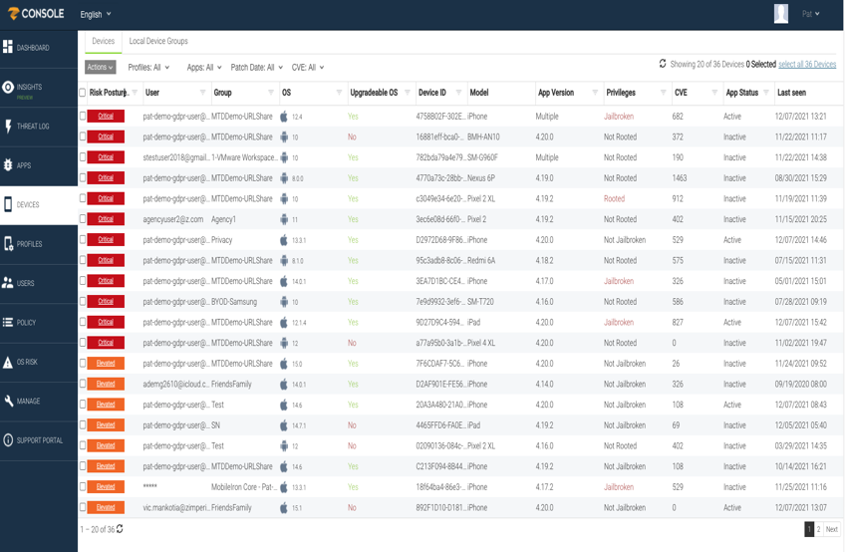
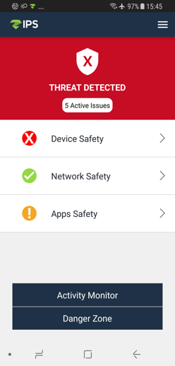








LMNTRIX MOBILE Overview
Easy to deploy and manage
Integrated with all major MDMs
  Easy deployment via MDM
  Conditional access: lock down access as risk increases
Single console
  Shared workflows for alerts, devices, and app inventory
Strong privacy controls
GDPR compliant, BYOD safe
The engine never collects user content, messages
Advanced privacy features
  Disable Application Inventory
  Disable collection of network details like SSID
Behavior-based malware detection
Phishing
prevention
Untrusted network
detection
MITM
detection
Jailbroken device
detection
App inventory
with risk scores
Deep inspection
for apps
Device pin
not set

Slide 12
Industry Leading on Device Detection Engine
Malicious Apps
Abnormal Process Activity
Phishing Attacks –
Link tapped
Google Play Protect Disabled
Mobile Alerts
System Tampering
Unsecured
Wi-Fi Networks
Rogue Access Points
Out of Compliance App
Developer Mode
Detections
Android Debug Bridge - Unverified app
Device Pin Not Set
Side-Loaded Apps
Network Handoff
Phishing Attacks - Link Visited
DNS Change to Unknown
Danger Zones:
Networks with Past Attacks
Proxy Change
Jailbroken Device
Danger Zones: Networks with Past Attacks
Device Not Using Encryption
ARP Scan
File System Change
Elevation of Privileges
Suspicious Profile
Unknown Sources Enabled

Slide 13

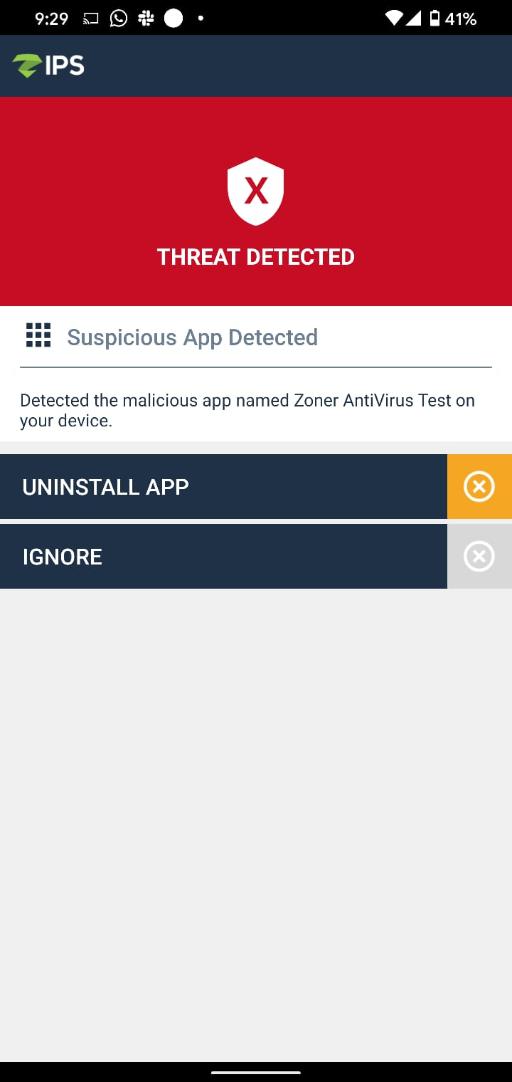
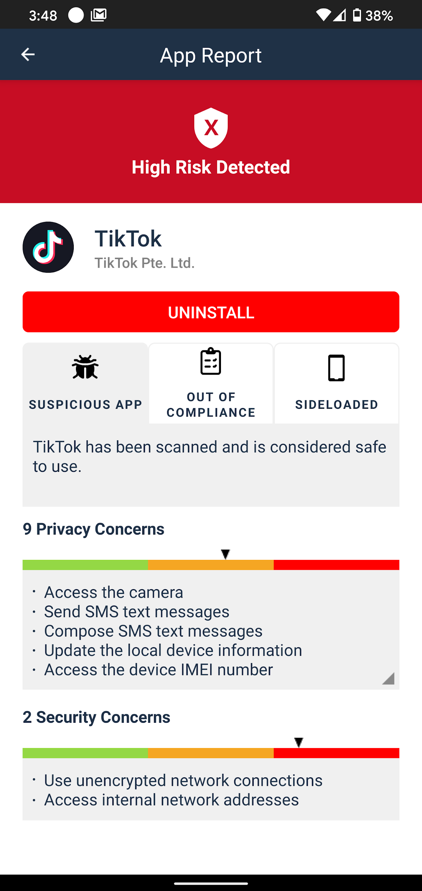
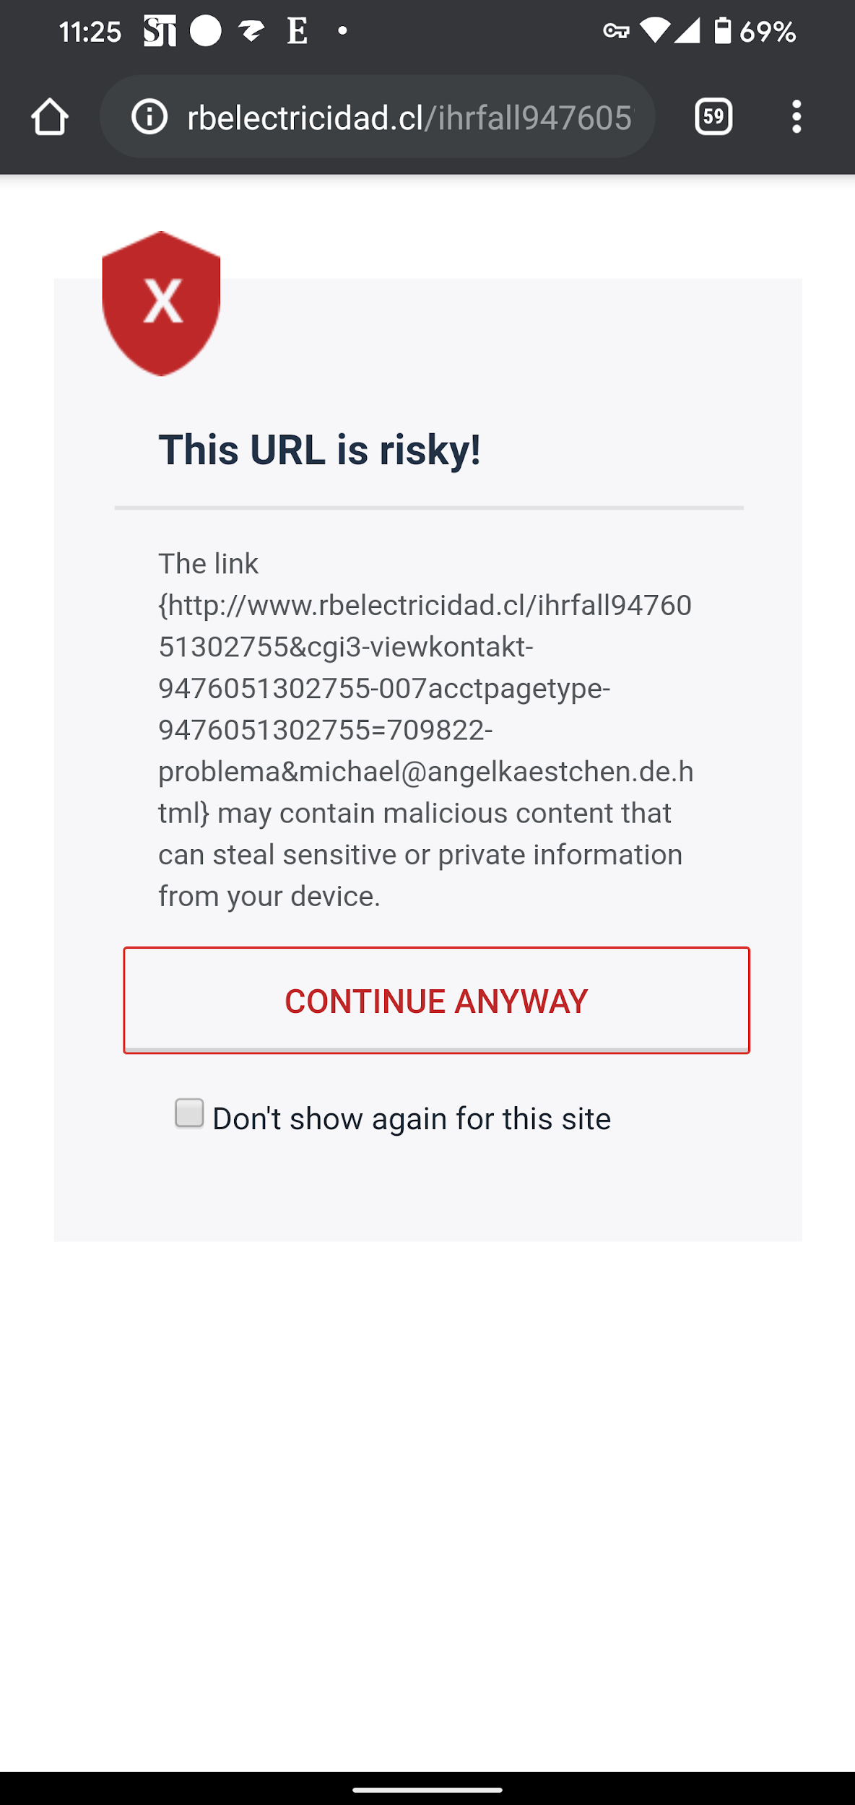
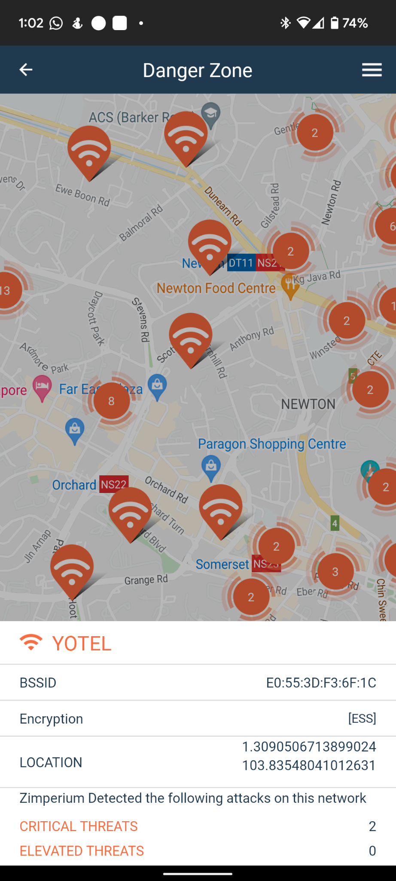
Mobile Risk
Device Risk
Malware
App Risk
Phishing
DangerZone

Slide 14






MDM/EMM/UEM + LMNTRIX = Complete Mobile Security
S
MDM
MTD
Build your foundation
Prevent malicious
Cyberattacks:
Phishing attacks
Man-in-the-Middle attacks
Reconnaissance Scans
Malicious Apps & Profiles
Rogue Wi-Fi APs
OS Exploits
Web Browser Attacks
Etc…
Enable Work Container
Deploy apps
Set Policy & Hardening
Monitor compliance
EMM

Slide 15
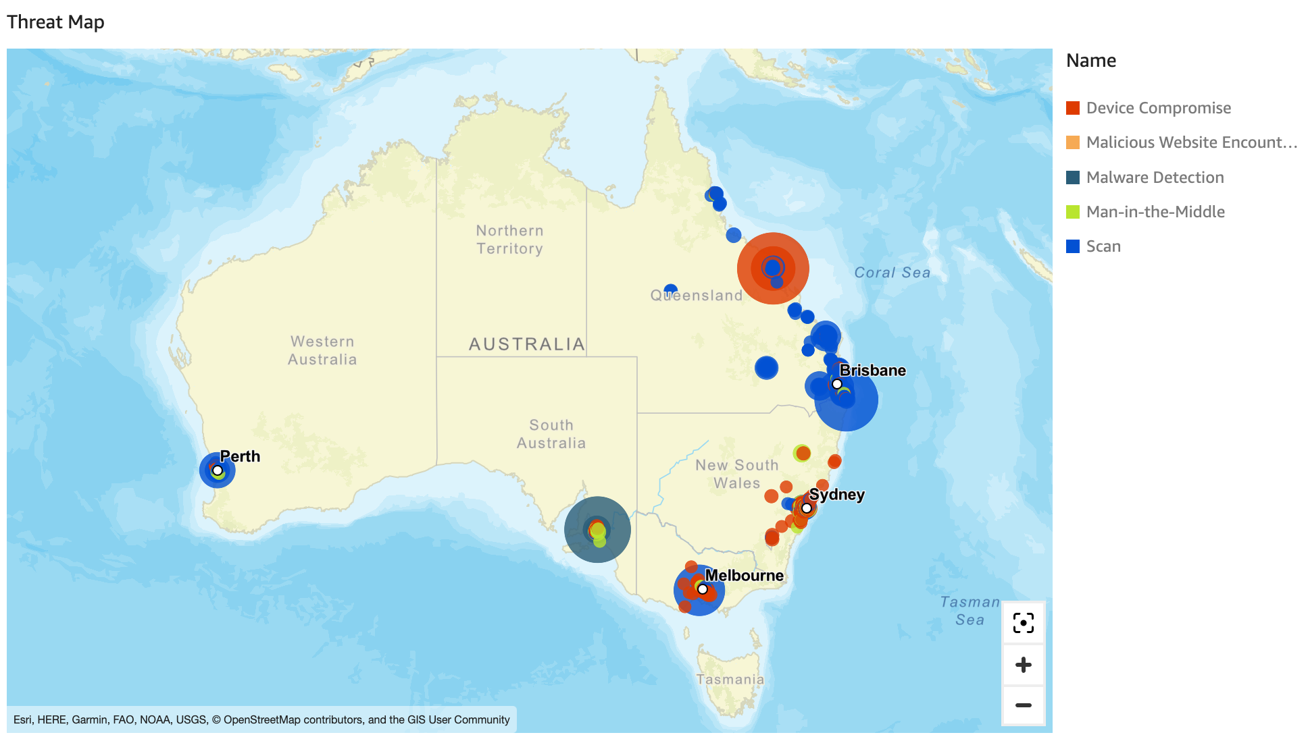
Australian Mobile Threats: Oct 2022

Slide 16
LMNTRIX’s
Unique Enterprise Capabilities
Only on-device detection solution
Anti-phishing security using hybrid on-device and cloud-based learning
Privacy by design
Cloud, on-premise and FedRAMP ready
Access to threat research and advisory services
Only MTD solution to operate on any cloud or on-premises
Security features and capabilities across iOS, Android, and ChromeOS

Slide 17
Overall the reasons why customers pick us:
Extensive Threat Protection: There is very little competition in terms of Zero Day, and even known threat detection. Our closest competitor Lookout is years behind in this space. Even based on recent testing, they were unable to detect 3-6 month old compromises, exploits and simple jailbreaks. We detected 100% as zero days, without any updates to our engine.
App Vetting capabilities: Competitors like Microsoft do not do any app vetting, they only look for malware. They do not provide reporting for security, privacy or scoring.
Web Content Filtering: We can filter traffic based on 75+ content categories.
Advanced Phishing Protection: We do not buy "Feeds and databases", we have zero reliance on known URLs. We have 7 classifiers that are highly capable of picking up zero day, never seen URLs. Customers have reported efficacy rates of over 90% of zero day URLs they've tested.
Network Detection: We excel in the space, with little competition. We have more out-of-box policies, and overall checks to detect network attacks. These are incredibly important to do well, since they are OS-Independant and can impact even the latest devices with up-to-date patches.
Zero Touch Deployment: We can activate the app without users needing to open it, allowing them to get adoption.

Slide 18


