Slide 1


ASSESS YOUR
OVERALL SECURITY
BEFORE ATTACKERS DO
August 2024

Slide 2





The Best Defense is a Good Offense.
Offensive Security
Defensive Security
Vulnerability Assessments
Implementing Controls
Penetration Testing
Security Monitoring
Social Engineering
Incident Response

Slide 3

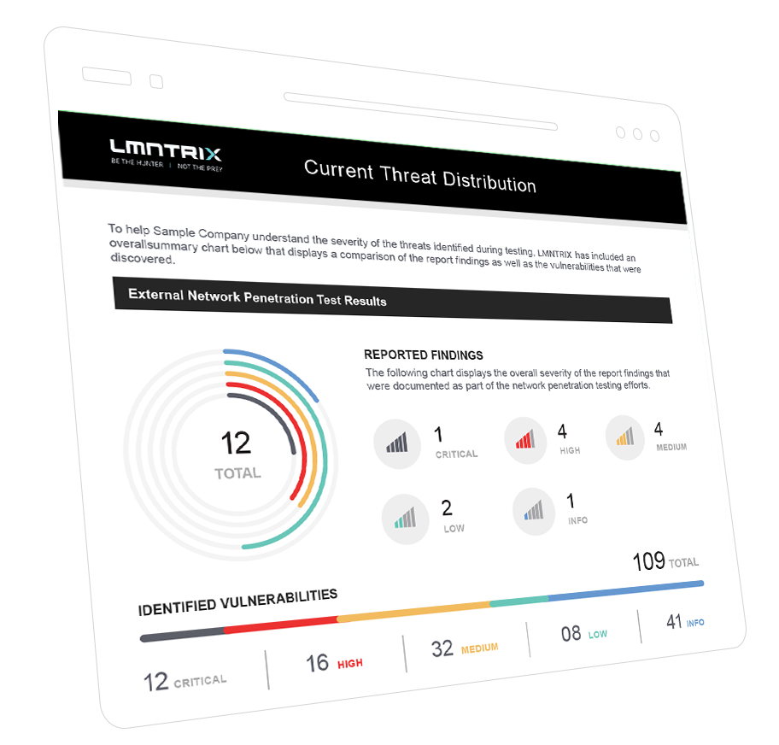

Automated Attack Validation (AAV) & its Purpose
01
Demonstrate real-world risk
by simulating a malicious threat actor
02
Evaluate current
Security detection and monitoring controls
03
Provide Businesses
with remediation strategies to mitigate risk
04
Understand how Attackers target
Their most confidential/sensitive data

Slide 4





Automated Attack Validation Works
Automated Attack Validation is unquestionably successful in revealing the potential paths that threat actors could take for breaking into and moving across your network to
Access
Manipulate
Damage
Sell
valuable data and systems within your organization. Focusing on defensive security alone, like many companies do, is a fundamentally flawed strategy.

Slide 5



Why Does Your Organization Need
Automated Attack Validation ?
AAV allow organizations to assess their cyber security posture based on realistic attack scenarios, which enables them to address issues that would be overlooked if they followed a solely defensive approach.
AAV reveals crucial security flaws.
They expose issues beyond the scope of vulnerability assessments.

Slide 6

Automated Attack Validation is Worth Every Penny
Using the results of a penetration test, your organization can identify ways to protect its most valuable data by reducing the number of attack vectors and accessible paths to sensitive resources and systems.

Slide 7
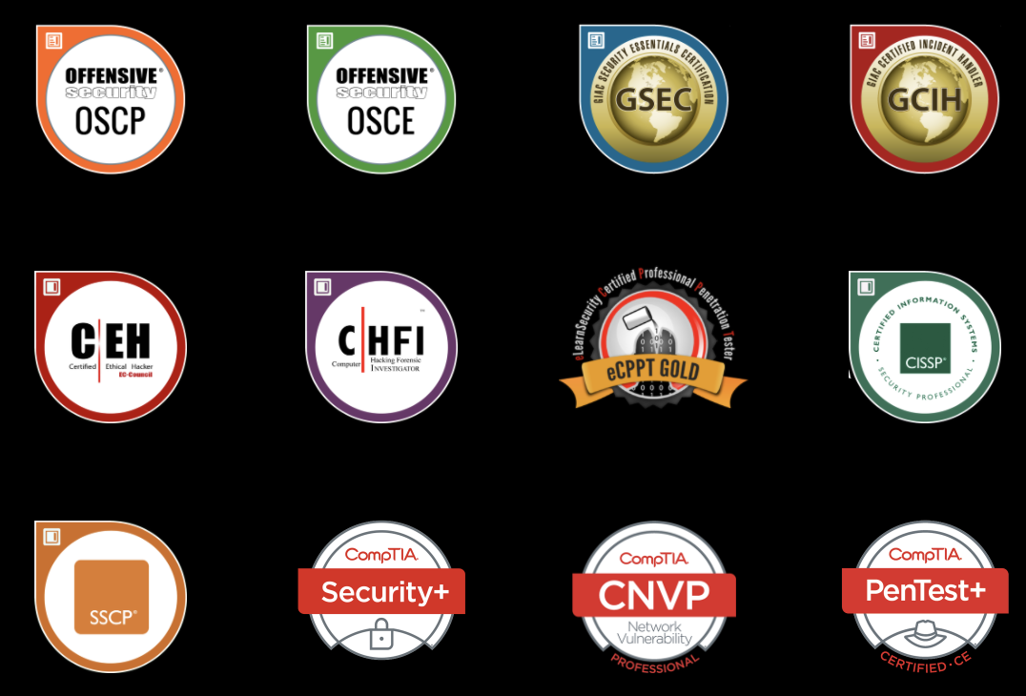
Red Team On Demand
Take advantage of the expertise of seasoned penetration testers without hiring one.
LMNTRIX AAV is equivalent to hiring a team of eCPPT, OSCP, and OSCE certified consultants with decades of experience and over 13 industry certifications to help you carry out a network penetration test with the click of a few buttons.

Slide 8
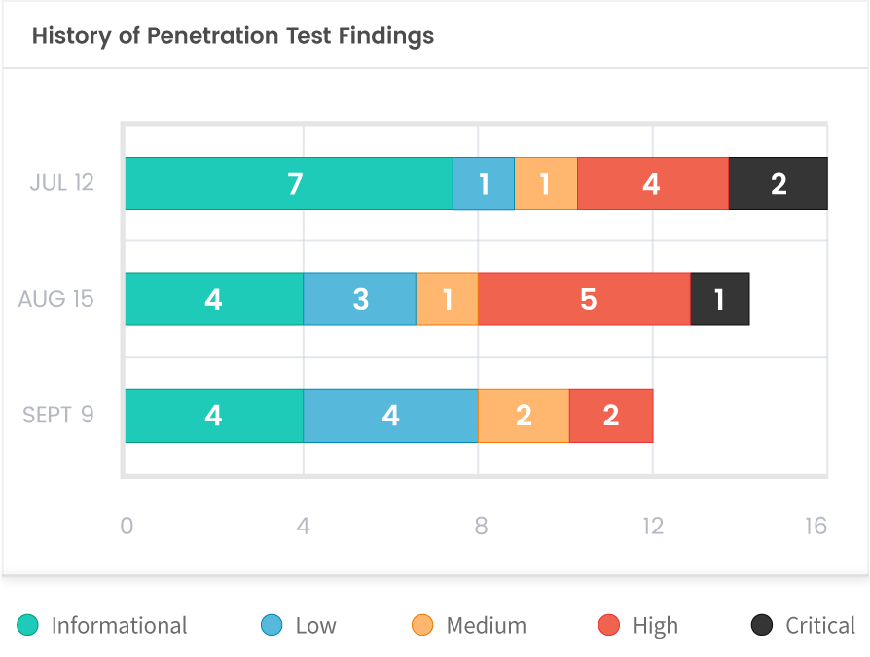
Automated Attack Validation
Our Modern Approach to PenTesting
We make network penetration testing easy, efficient, scalable, and affordable for businesses that take cyber security seriously.
Test your network monthly or as new threats emerge. Schedule a test within minutes and keep track of your organization’s risk profile in near real-time. Our reports will show you trending data, allowing your team to see improvements from one month to another.

Slide 9
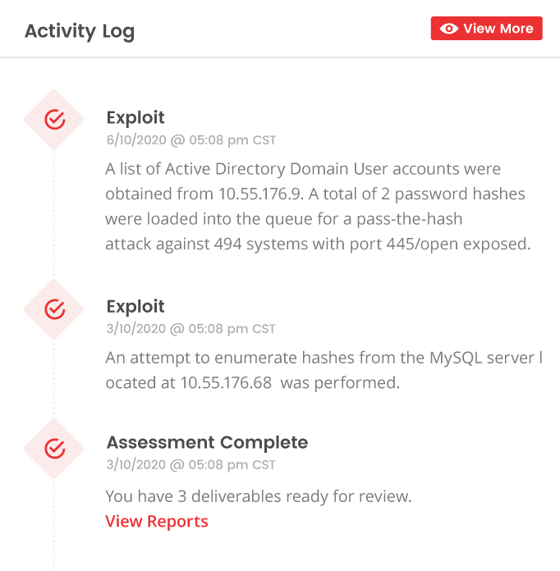
Real-time Visibility
Correlate our Activity Log with your SIEM and incident response procedures. Our real-time activity logs ensures your organization knows what’s happening and when. Find gaps in your security monitoring controls as the network penetration test occurs in real-time.

Slide 10
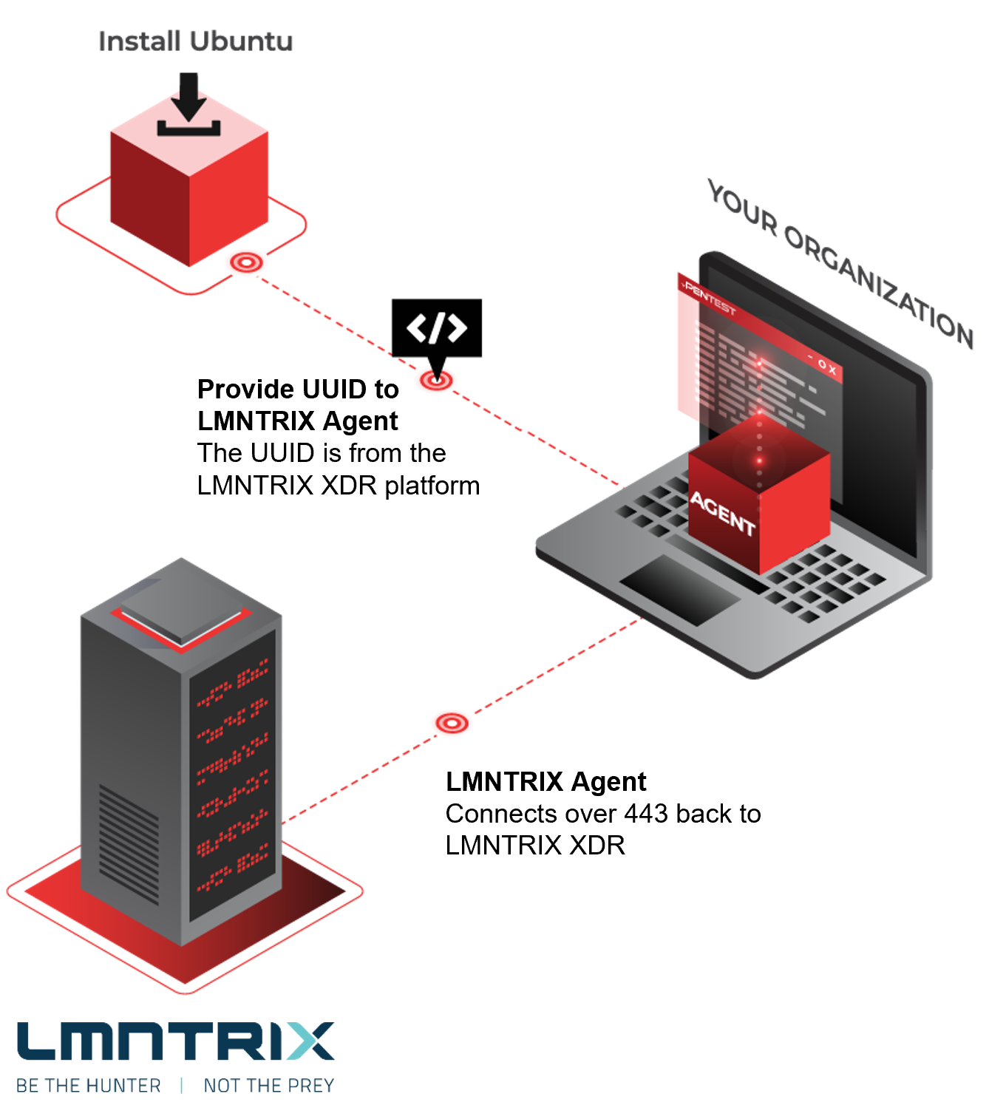

Save Time & Be in Control
Deploy an agent, schedule an internal assessment, and get detailed reports within a few days. You’re in command. You control the schedule, frequency, and scope of every assessment. Simply deploy, click and go.

Slide 11
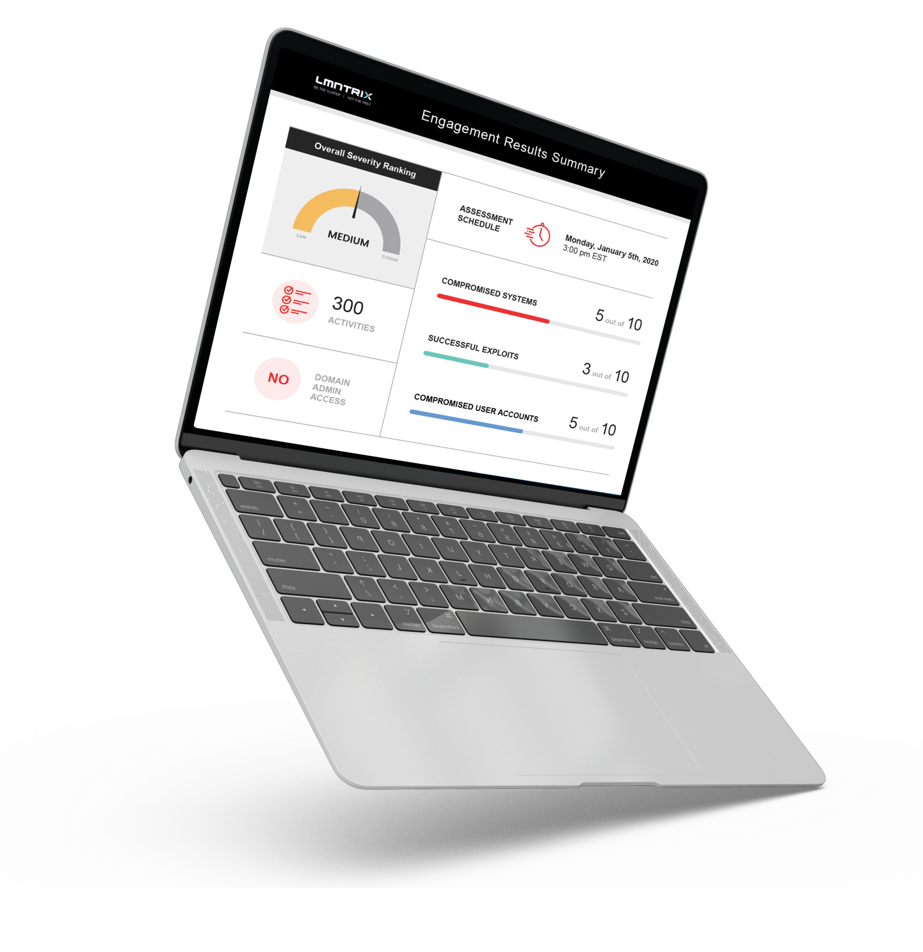
We make Penetration
Testing More Affordable
We deploy the latest technology that helps our team perform penetration testing more efficiently and we pass those savings to bring you Penetration Testing at an affordable cost.
AAV is more Penetration Tests without breaking the bank
Up to 50% saving compared to traditional approach

Slide 12
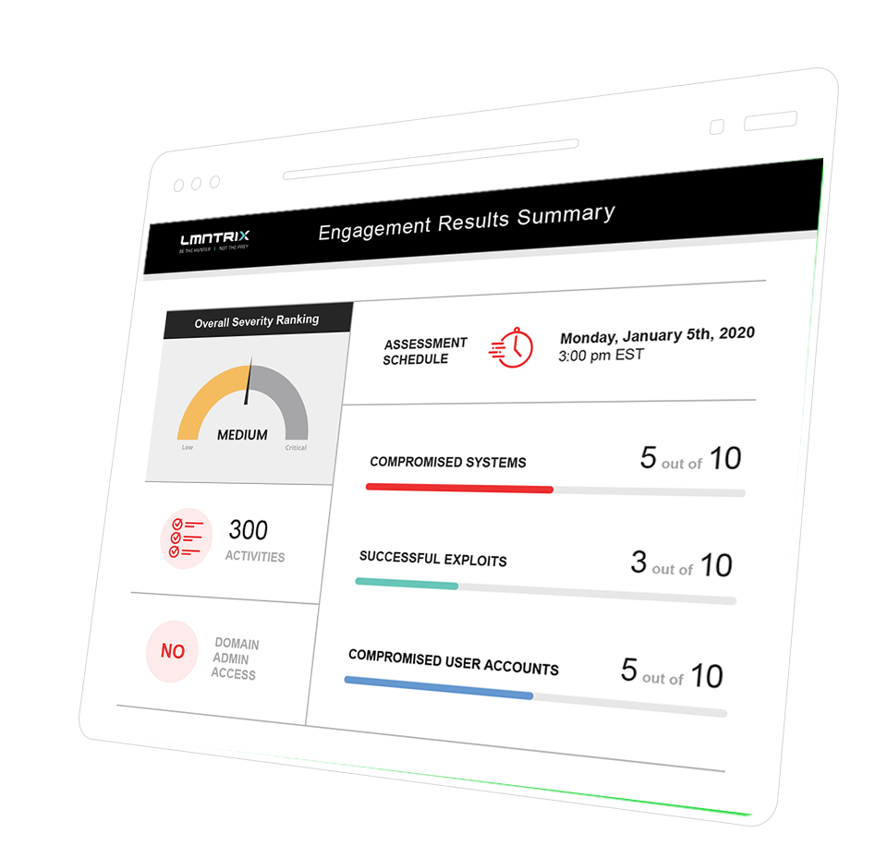
We make Penetration
Testing More Valuable.
Email and SMS notifications to stay in the loop during the penetration test
Real-time tracking of attacks and findings
Reports are available within 24 hours
after a penetration test is complete

Slide 13
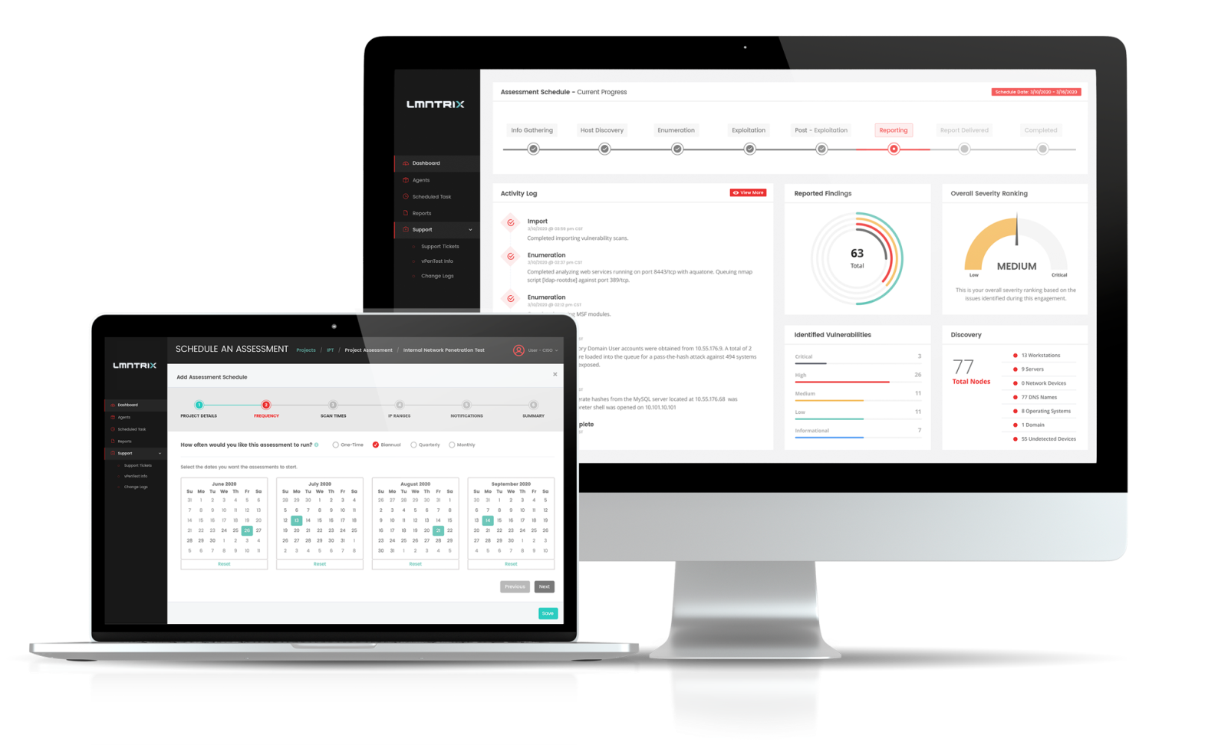
We makes Penetration
Testing EASY
IP Addresses per month changeable each month
Internal or External IP Addresses
From 5 to 5000 IP Addresses per month
Helps show management issues on Critical systems

Slide 14

info@lmntrix.com

